Slide 1
NAME:SAMSON MUREU
TASK: model which is able to classify whether a blood smear is uninfected or parasitized.

Slide 2
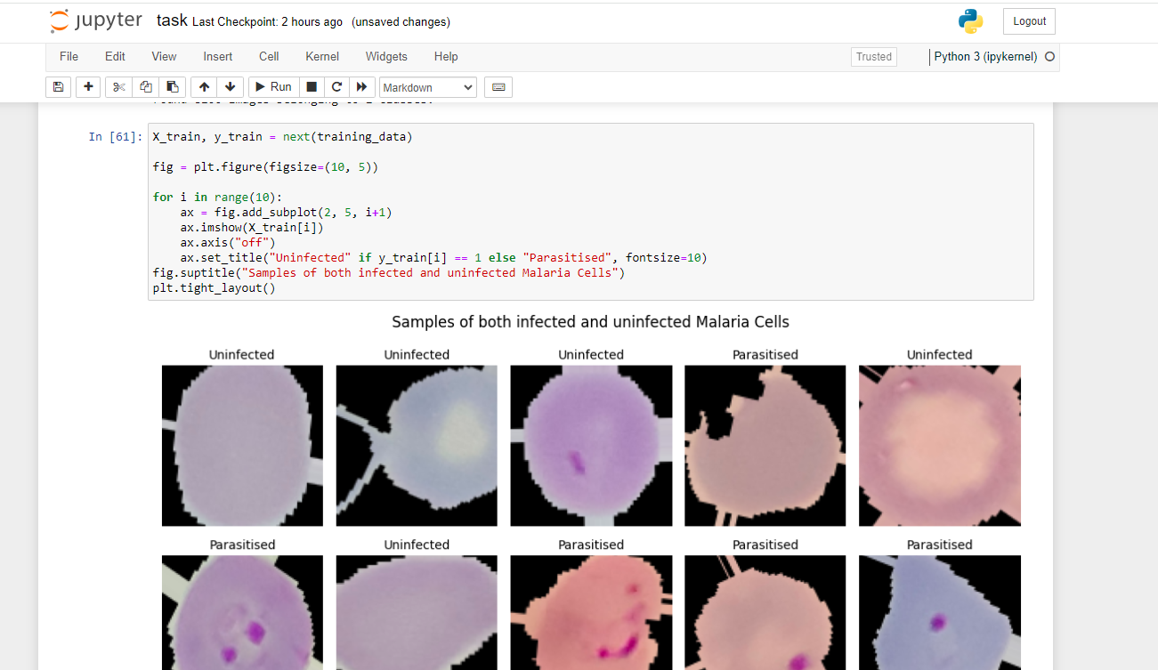
Samples of both infected and uninfected malaria cells

Slide 3
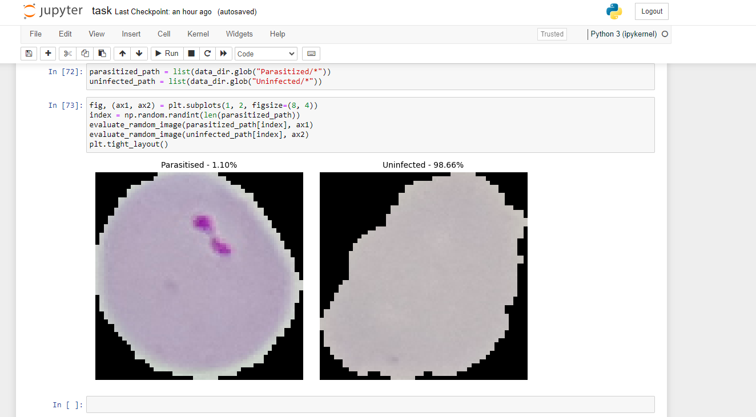
screenshots/images of model training

Slide 4
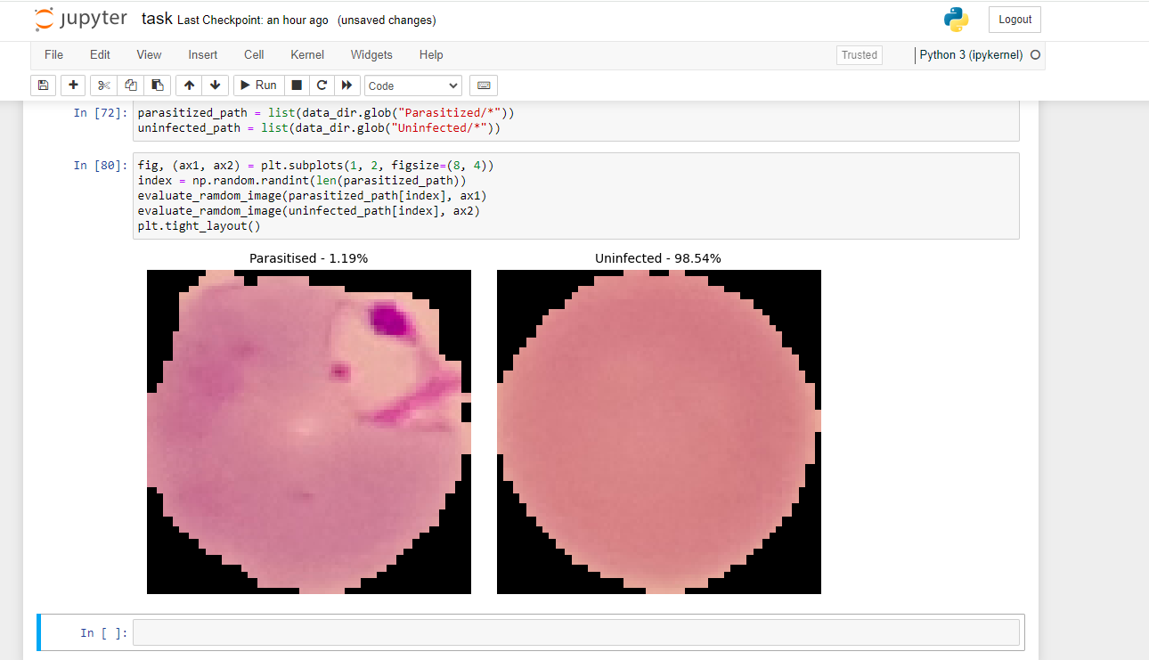
screenshots/images of model training

Slide 5
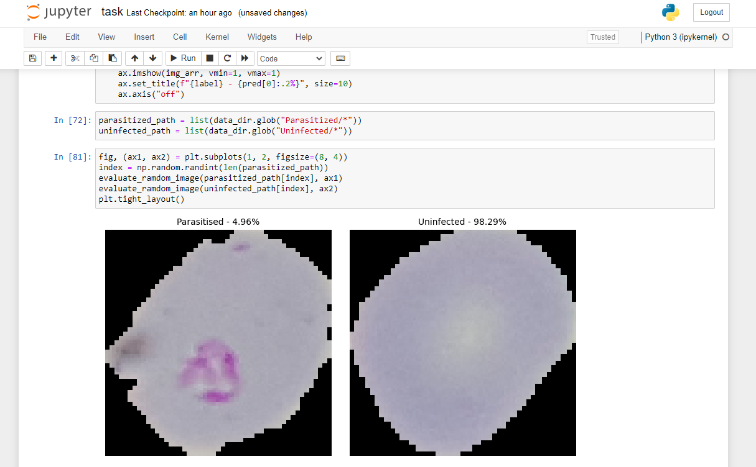
screenshots/images of model training

Slide 6
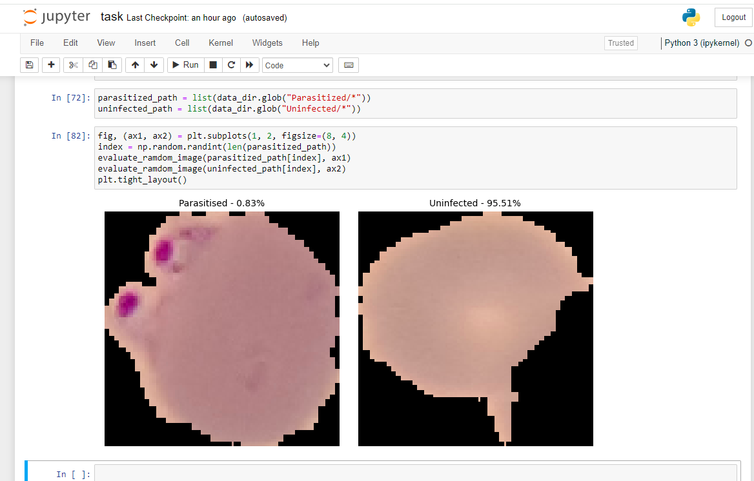
screenshots/images of model training

